Slide 1
Performance Guidelines of Neural Network Models: Perspective of Operation Efficiency
May 19. 2020

Slide 2
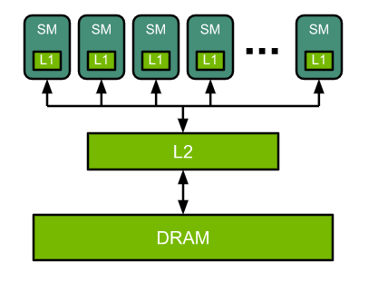
Diagram of Simplified GPU Architecture

Slide 3
To utilize their parallel resources, GPUs execute many threads concurrently.
GPUs execute functions using a 2-level hierarchy of threads.
GPUs hide dependent instruction latency by switching to the execution of other threads.
The 2-level thread hierarchy is a result of GPUs having many SMs, each of which in turn has pipelines for executing many threads and enables its threads to communicate via shared memory and synchronization.

Slide 4
Understanding Performance
Performance of a function on a given processor is limited by memory bandwidth, math bandwidth or latency.
Math limited – #ops/BW_{math} > #bytes/Bw_{mem}
the inequality can be rearranged to:
#ops/#bytes > BW_{math}/Bw_{mem}

Slide 5
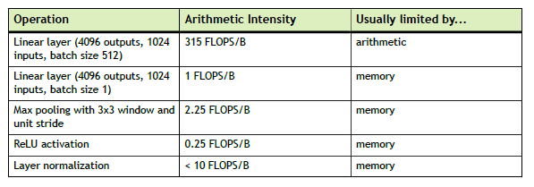
NVIDIA Volta V100 GPU:
peak math rate of 125 FP16 Tensor TFLOPS
memory bandwidth of approx. 900 GB/s (off-chip), 3.1 TB/s (on-chip)
→ giving it a #ops/#bytes ratio between 40 and 139

Slide 6
Most likely performance is limited by:
‣ Latency if there is not sufficient parallelism
‣ Math if there is sufficient parallelism and algorithm arithmetic intensity is higher than the GPU #ops/#bytes ratio.
‣ Memory if there is sufficient parallelism and algorithm arithmetic intensity is lower than the GPU #ops/#bytes ratio.

Slide 7
Deep Neural Network Operation Categories
Elementwise Operations
Examples: ReLU, Sigmoid …
These layers tend to be memory-limited
Reduction Operations
Examples: Pooling, Batchnormailzation …
The reduction operations have low arithmetic intensity and thus are memory limited
Dot-Product Operations
Examples: weight tensor, activation tensor… Fully-connected layer, Convolution
Math-limited if the corresponding matrices large enough
Memory-limited if the sizes of the matrix are small

Slide 8
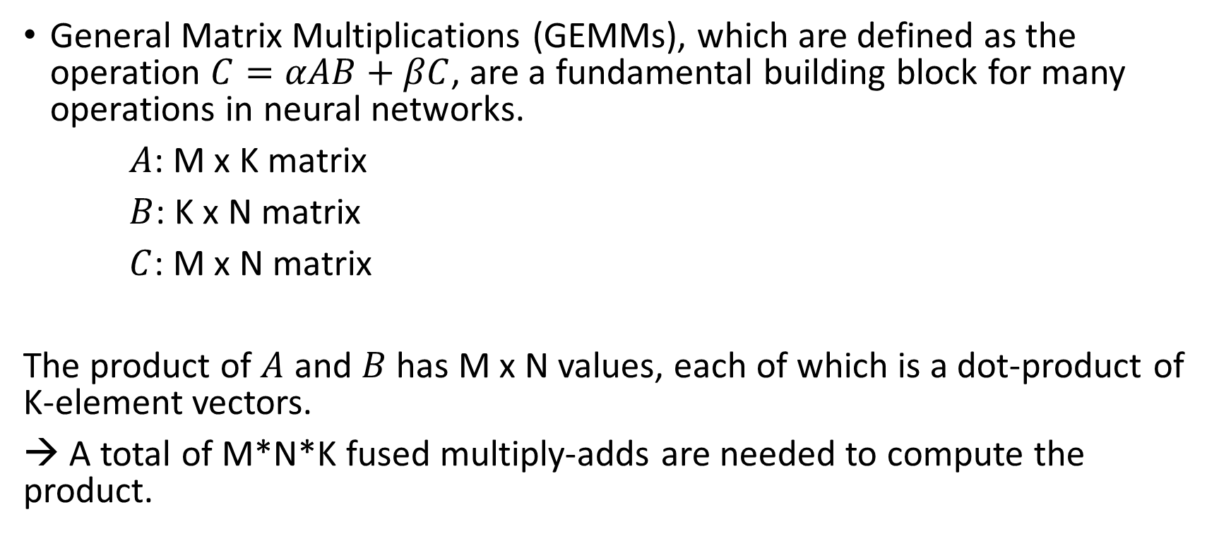
Matrix-Matrix Multiplication
General Matrix Multiplications (GEMMs), which are defined as the operation $C=αAB+βC$, are a fundamental building block for many operations in neural networks.
$A$: M x K matrix
$B$: K x N matrix
$C$: M x N matrix
The product of $A$ and $B$ has M x N values, each of which is a dot-product of K-element vectors.
→ A total of M*N*K fused multiply-adds are needed to compute the product.

Slide 9
Matrix-Matrix Multiplication
Each multiply-add is 2 operations, a multiply and an add.
2*M*N*K flops are required.
Compare the arithmetic intensity to the #ops/#bytes ratio to estimate if the particular matrix multiply is math or memory limited.
Ex:
Tesla V100 GPU: FLOPs/B ratio = 138.9

Slide 10
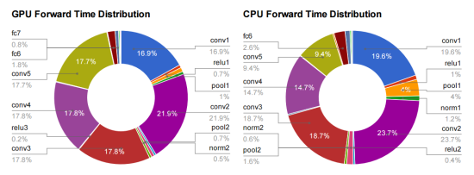
Notes:
to make deep learning with neural networks faster and more power efficient. In practice that means focusing on a function called GEMM. It’s part of the BLAS (Basic Linear Algebra Subprograms) library.
To explain why it’s so important, here’s a diagram that breaks down where the time’s going for a typical deep convolutional neural network doing image recognition using Alex Krizhevsky’s Imagenet architecture. All of the layers that start with fc (for fully-connected) or conv (for convolution) are implemented using GEMM, and almost all the time (95% of the GPU version, and 89% on CPU) is spent on those layers.

Slide 11
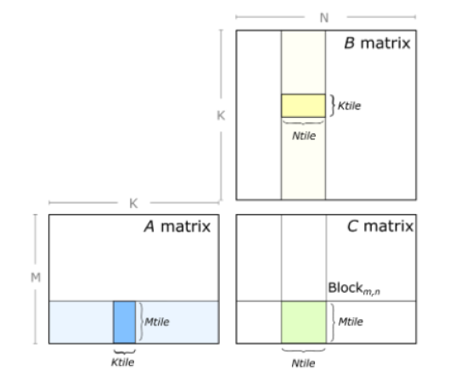
GPU implementation
GPUs implement General Matrix Multiplications (GEMMs) by partitioning the output matrix into tiles, which are then assigned to thread blocks.

Slide 12
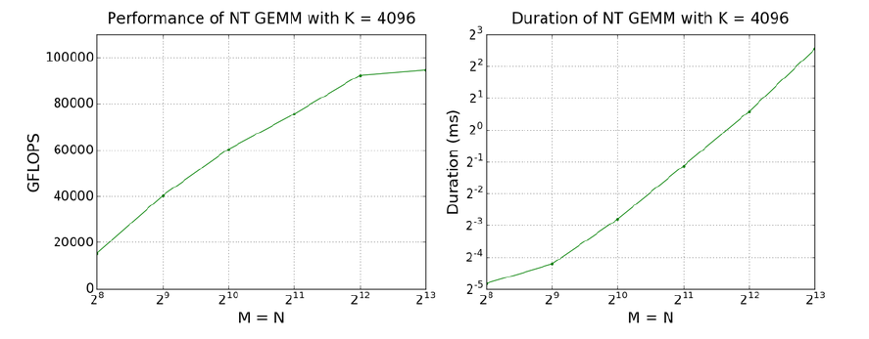
Performance improves as the M-N footprint of the General Matrix Multiplication (GEMM) increases. Duration also increases, but not as quickly as the M-N dimensions themselves.
It is sometimes possible to increase the GEMM size (e.g. use more weights) for only a small increase in duration.

Slide 13
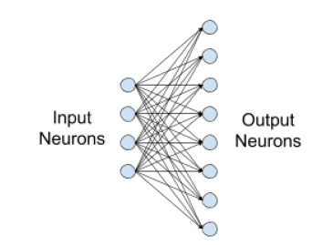
Fully-connected Layer
Three parameters define a fully-connected layer: batch size, number of inputs, and number of outputs.
Forward propagation, activation gradient computation, and weight gradient computation are directly expressed as matrix-matrix multiplications.
Notes:
Fully-connected layers are commonly used in neural networks, and connect every input
neuron to every output neuron.

Slide 14
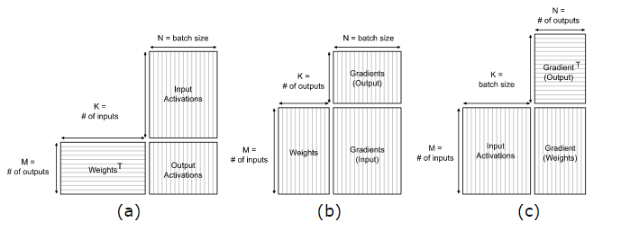
The compositions of the matrices in the GEMM
Dimensions of equivalent GEMMs for (a) forward propagation, (b) activation gradient, and (c) weight gradient computations of a fully-connected layer
Notes:
As fully-connected layers directly correspond to GEMMs, their performance trends are identical to those described previously, which is:

Slide 15
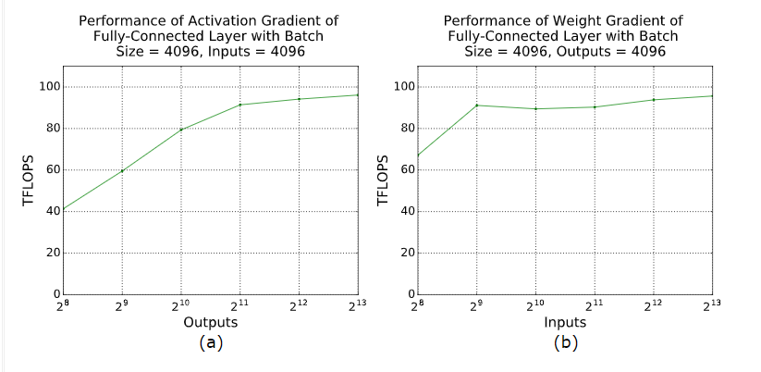

Slide 16
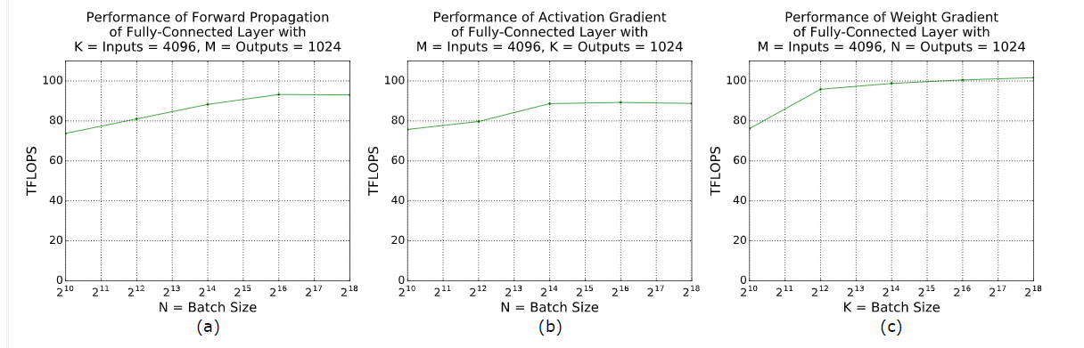
Batch size
Performance data for (a) forward propagation, (b) activation gradient computation, and (c) weight gradient computation for a fully connected layer with 4096 inputs, 1024 outputs, and varying batch size.
Tesla V100-SXM3-32GB GPU, cuBLAS v10.1

Slide 17
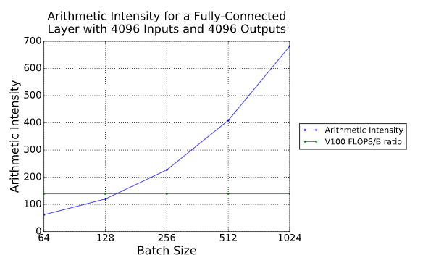

Slide 18
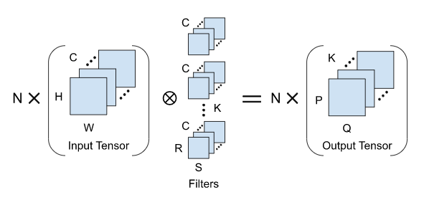
Convolution Layer
The minimum parameter set required to define a convolution
Convolution of an NCHW input tensor with a KCRS weight tensor, producing a NKPQ output

Slide 19
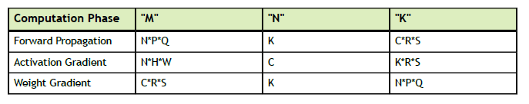
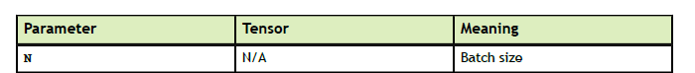
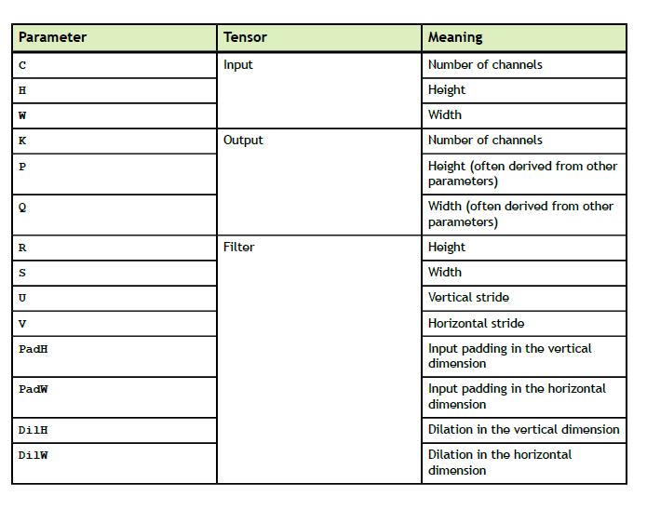
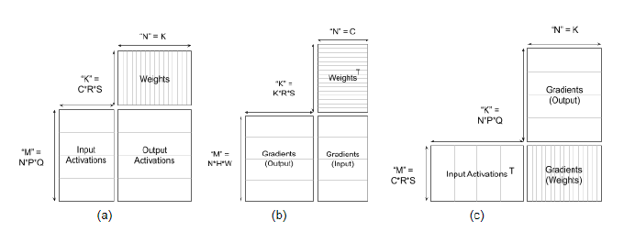
Translation of convolution parameters to corresponding GEMM parameters
Parameters defining a convolution
Dimensions of equivalent GEMMs for (a) forward convolution, (b) activation gradient calculation, and (c) weight gradient calculation

Slide 20
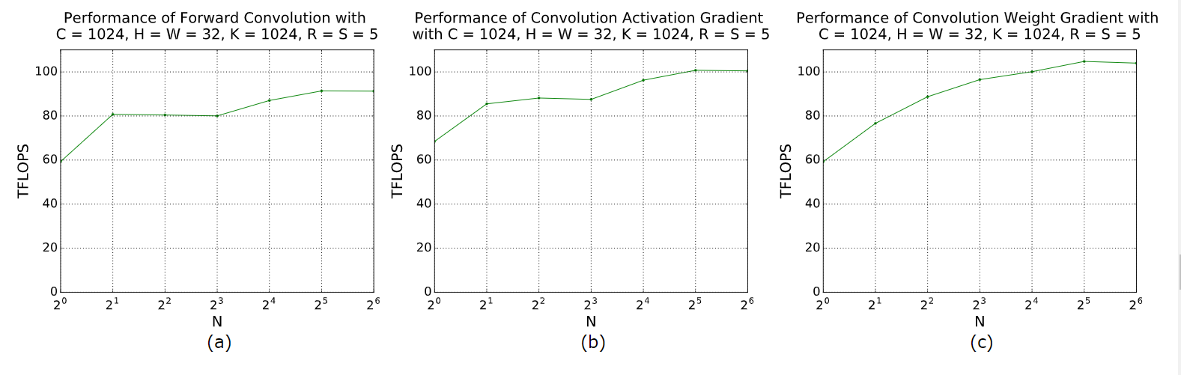
High-Performance Example
Good performance can be seen for the convolutions with larger batch sizes here, above 100 TFLOPS for activation and weight gradient computation.
Tesla V100-SXM3-32GB GPU, cuDNN v7.5.

Slide 21
TL;DR
For fully-connected layers:
‣ Choose batch size and the number of inputs and outputs to be divisible by 8 (FP16) /16 (INT8) to enable Tensor Cores.
‣ Especially when one or more parameters are small, choosing batch size and the
number of inputs and outputs to be divisible by at least 64 and ideally 256 can
streamline tiling and reduce overhead.
‣ Larger values for batch size and the number of inputs and outputs improve
parallelization, thereby improving GPU efficiency.
‣ As a rough guideline, batch sizes or neuron counts less than 128 will lead to the
layer being limited by memory bandwidth, not computation rate (Tesla V100).

Slide 22
The following quick-start checklist provides specific tips for convolutional layers.
Choose the number of input and output channels to be divisible by 8 to enable Tensor Cores. For the first convolutional layer in most CNNs where the input tensor consists of 3-channel images, padding to 4 channels is sufficient if a stride of 2 is used.
Choose parameters (batch size, number of input and output channels) to be divisible by at least 64 and ideally 256 to enable efficient tiling and reduce overhead.
Larger values for size-related parameters (batch size, input and output height and width, and the number of input and output channels) can improve parallelization. As with fully-connected layers, this speeds up an operation’s efficiency, but does not reduce its absolute duration.
NVIDIA libraries offer a set of different convolution algorithms with different performance behaviors, dependent on the convolution’s parameters.
When the size of the input processed by the network is the same in each iteration, autotuning is an efficient method to ensure the selection of the ideal algorithm for each convolution in the network. For TensorFlow, autotuning is enabled by default. For PyTorch, enable autotuning by adding torch.backends.cudnn.benchmark = True to your code.
Choose tensor layouts in memory to avoid transposing input and output data. There are two major conventions, each named for the order of dimensions: NHWC and NCHW. We recommend using the NHWC format where possible. This is supported natively in MXNet and available through XLA in TensorFlow.

Slide 23
For activation functions, pooling, and similar operations:
‣ The speed of these routines is limited by data movement speed (as opposed to calculation speed), and hence Tensor Core acceleration is not used.

